Slide 1
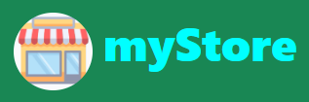
MYSTORE WEB site mini project one
GARRY M. CACHO, 44yo
An Electrical Engineer by day, and a C++ programmer by night
www.garrymcacho.com
Notes:
Good day everyone, specially to all the panelist and my fellow Kodegeeks.
Thank you for granting the time to be here.
I am proud to present the output of mini project 1,
entitled myStore Web Site.
By the way, I am Garry Cacho, 44years old, I plan to be a trade shifterhappily married for 11 years and a father of a 3 year old daughter

Slide 2
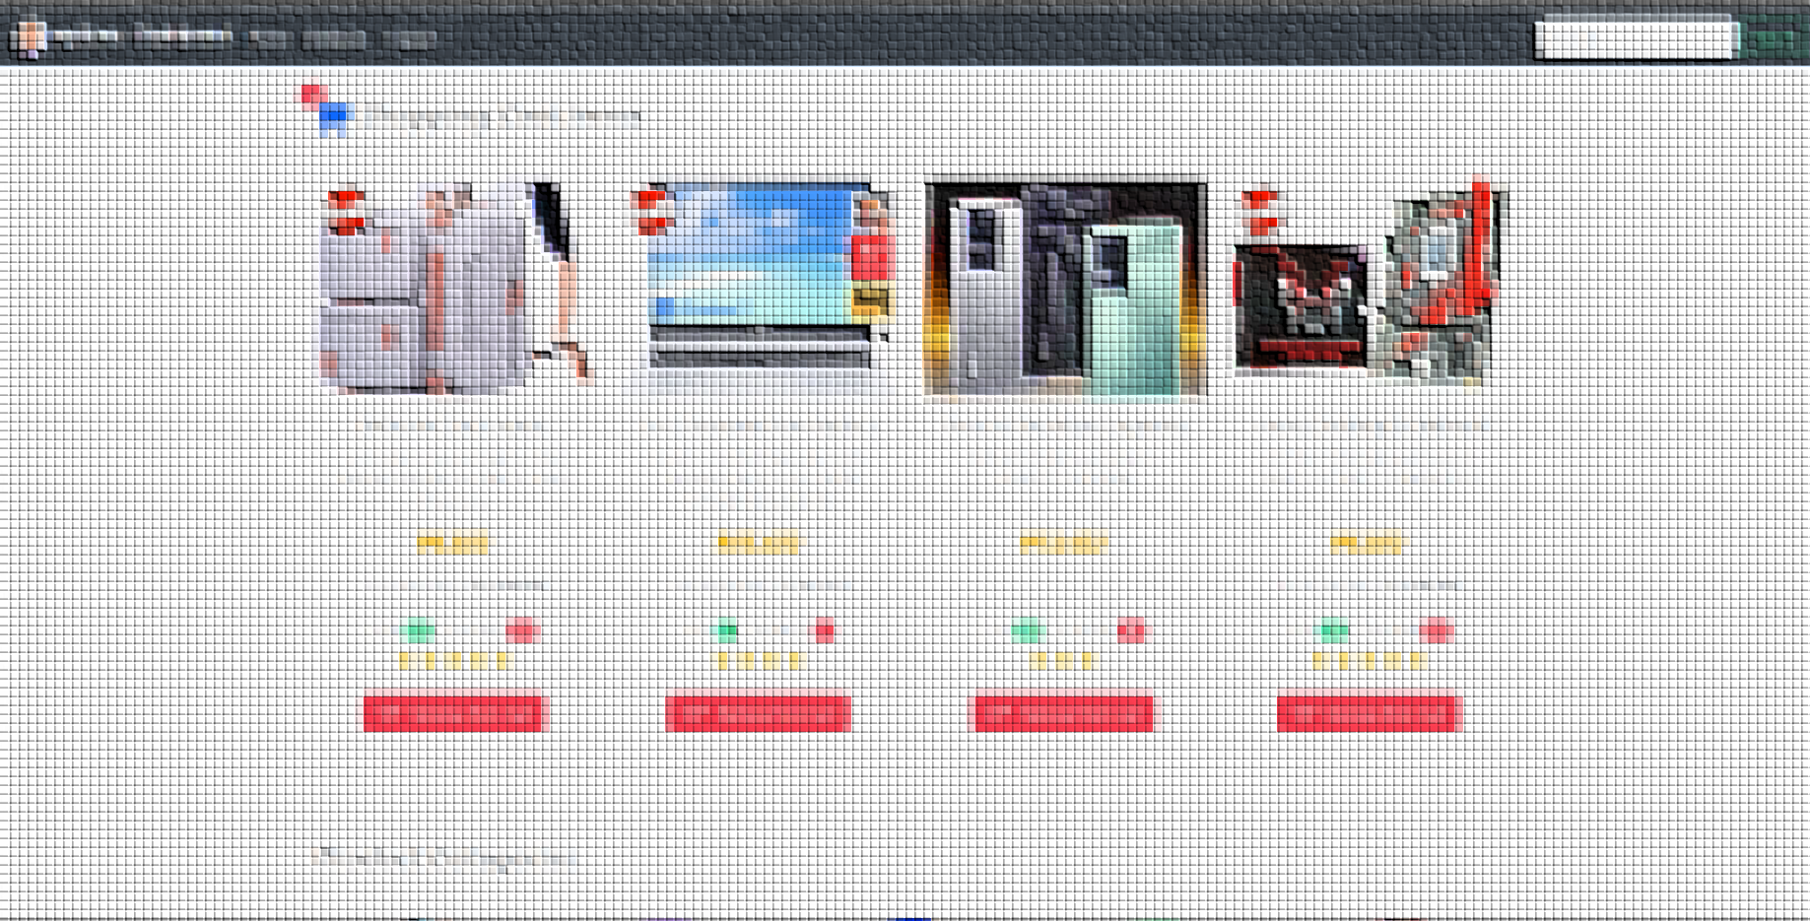
Brief Introduction
Notes:
Introduction

Slide 3
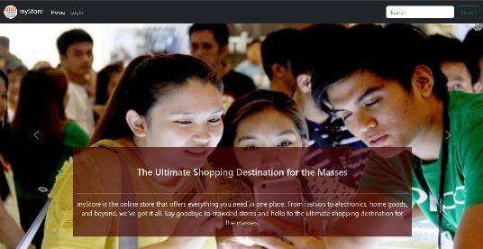
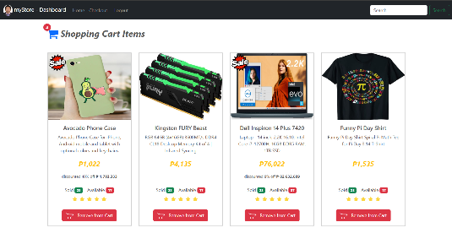
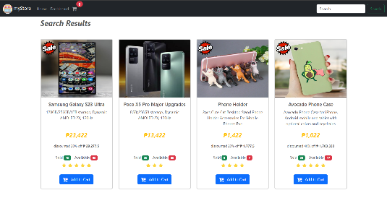
Modern and user-friendly online store web app
Mobile responsive design, accessible from any device.
Advanced product item search and filtering function
Notes:
myStore Web site, is a mock implementation of a user-friendly online store
I used bootstrap framework, to make the website responsive.
It has also product search features

Slide 4
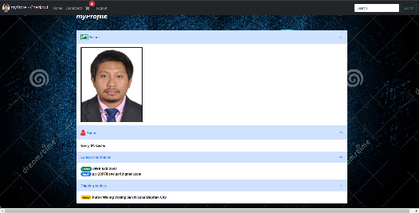
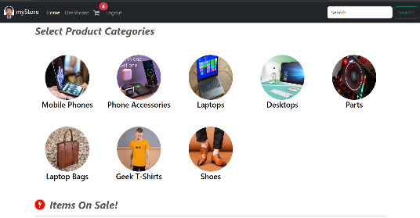
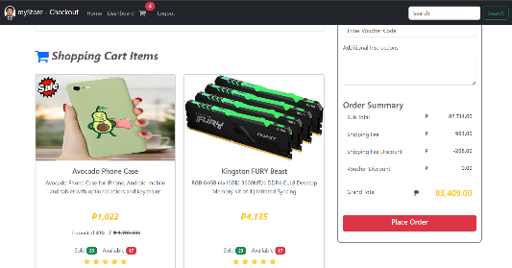
The web app has sign up, login, logout and user info features
Simple product categorization to make the app less cluttery
Clear representation of shopping cart and checkout
Notes:
Additionally, a security features for login and log out
To simplify the products presentation, products are grouped into categories
It has also shopping cart and checkout function

Slide 5
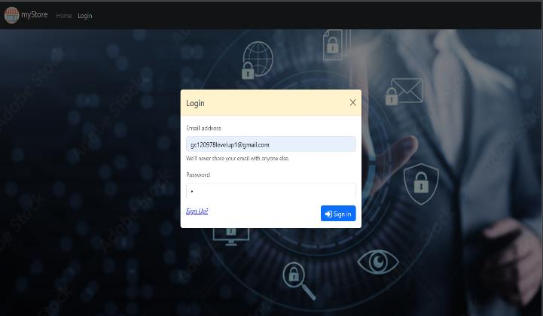
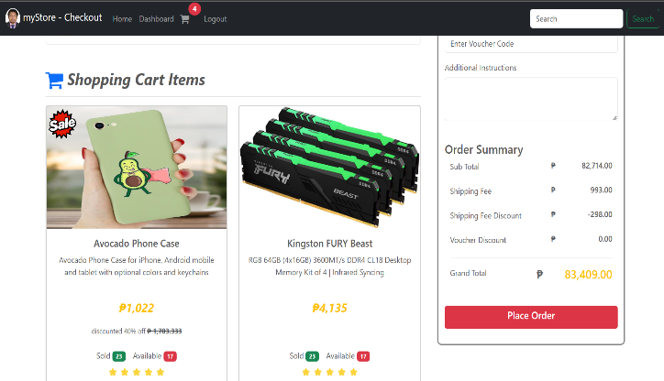
Objectives of the project
To handle employers requirement for basic e-commerce platform that can sell products and services.
To create a proof of concept on how to implement a simple online web app
Notes:
Objective:
Many businesses nowadays demand the need for a dedicated e-commerce platform that showcase their goods and services to the public.
Making this project can kickstart my experience in implementing e-commerce related application.
This project can be easily repurposed to cater any product and service
And to create a proof-of-concept on how to implement the visualization, logic and data flow of a simple online shopping web site

Slide 6

DEVELOPMENT PROCESS
Notes:
Development process

Slide 7
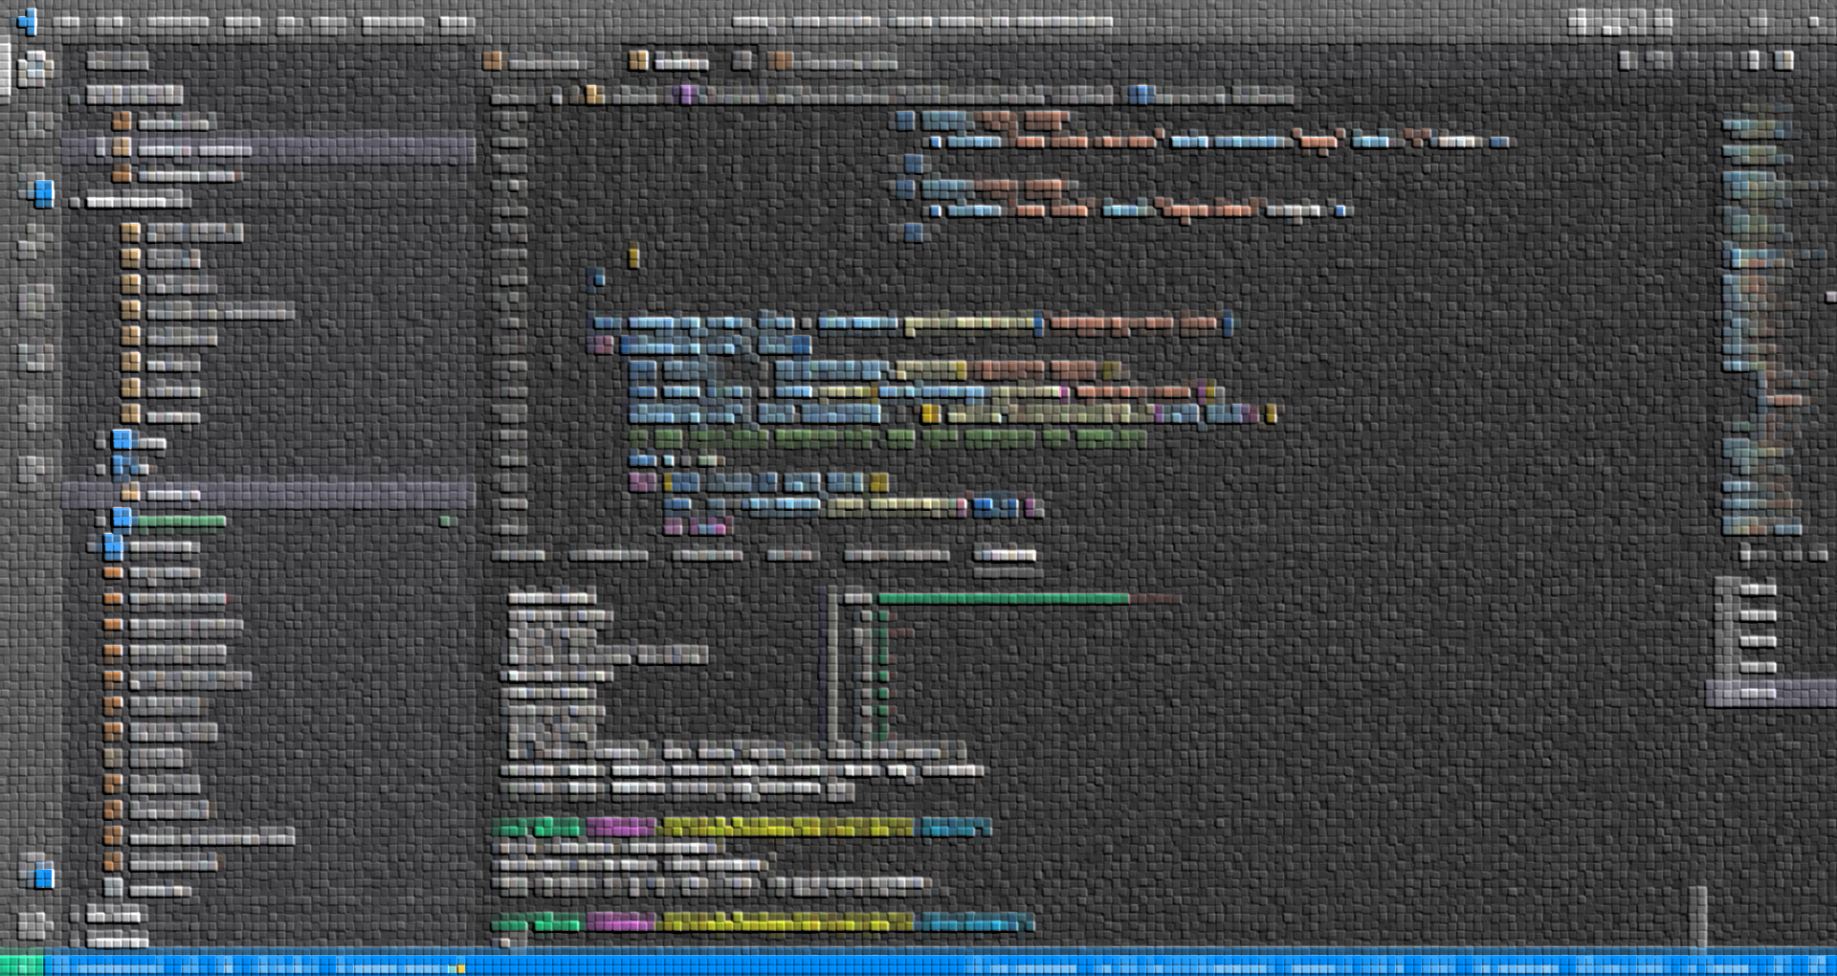
TechnologIES UTILIZED TO IMPLEMENT THE PROJECT
Notes:
First lets talk about the Technologies used

Slide 8





MODEL
JAVASCRIPT OBJECTS ARRAYS
VIEW
HTML, CSS, BOOTSTRAP 5,
VANILLA JS
CONTROLLER
VANILLA JAVASCRIPT
Notes:
I follow MVC design pattern.
For data modeling I used javascript object arrays.
For viewing and visualization, I used the combination of html5, css, and bootstrap.
I used vanilla javascript to render dynamic DOM that relates to object arrays.
And for controller, page routing and business logic I used vanilla JS.

Slide 9








IDE
VS CODE w/ HTML-CSS, TABNINE, LIVE SERVER
VERSION CONTROL
GIT AND GITHUB, MINGW-CLI
WEB SERVICE
XAMPP, GITHUB-PAGES
Notes:
For IDE I used vscode with installed extensions
For version control, git and github is used with mingw for bash CLI.
For local test deployment I used xampp and github pages for online deployment

Slide 10
GATHERING OF INFORMATION AND NECESSARY RESOURCES
Notes:
GATHERING OF INFORMATION AND NECESSARY RESOURCES

Slide 11
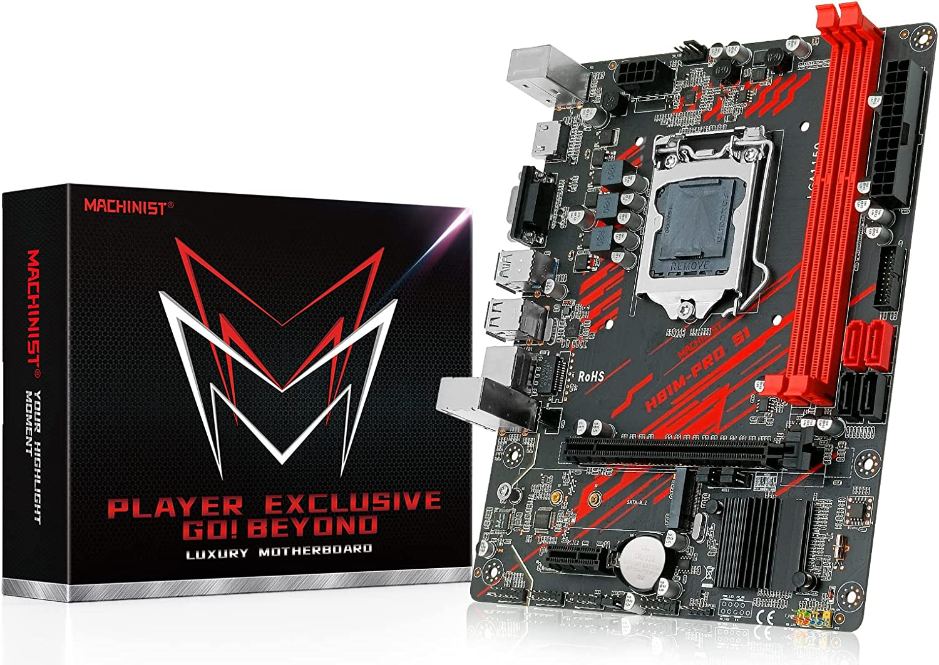
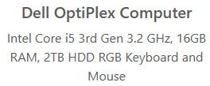
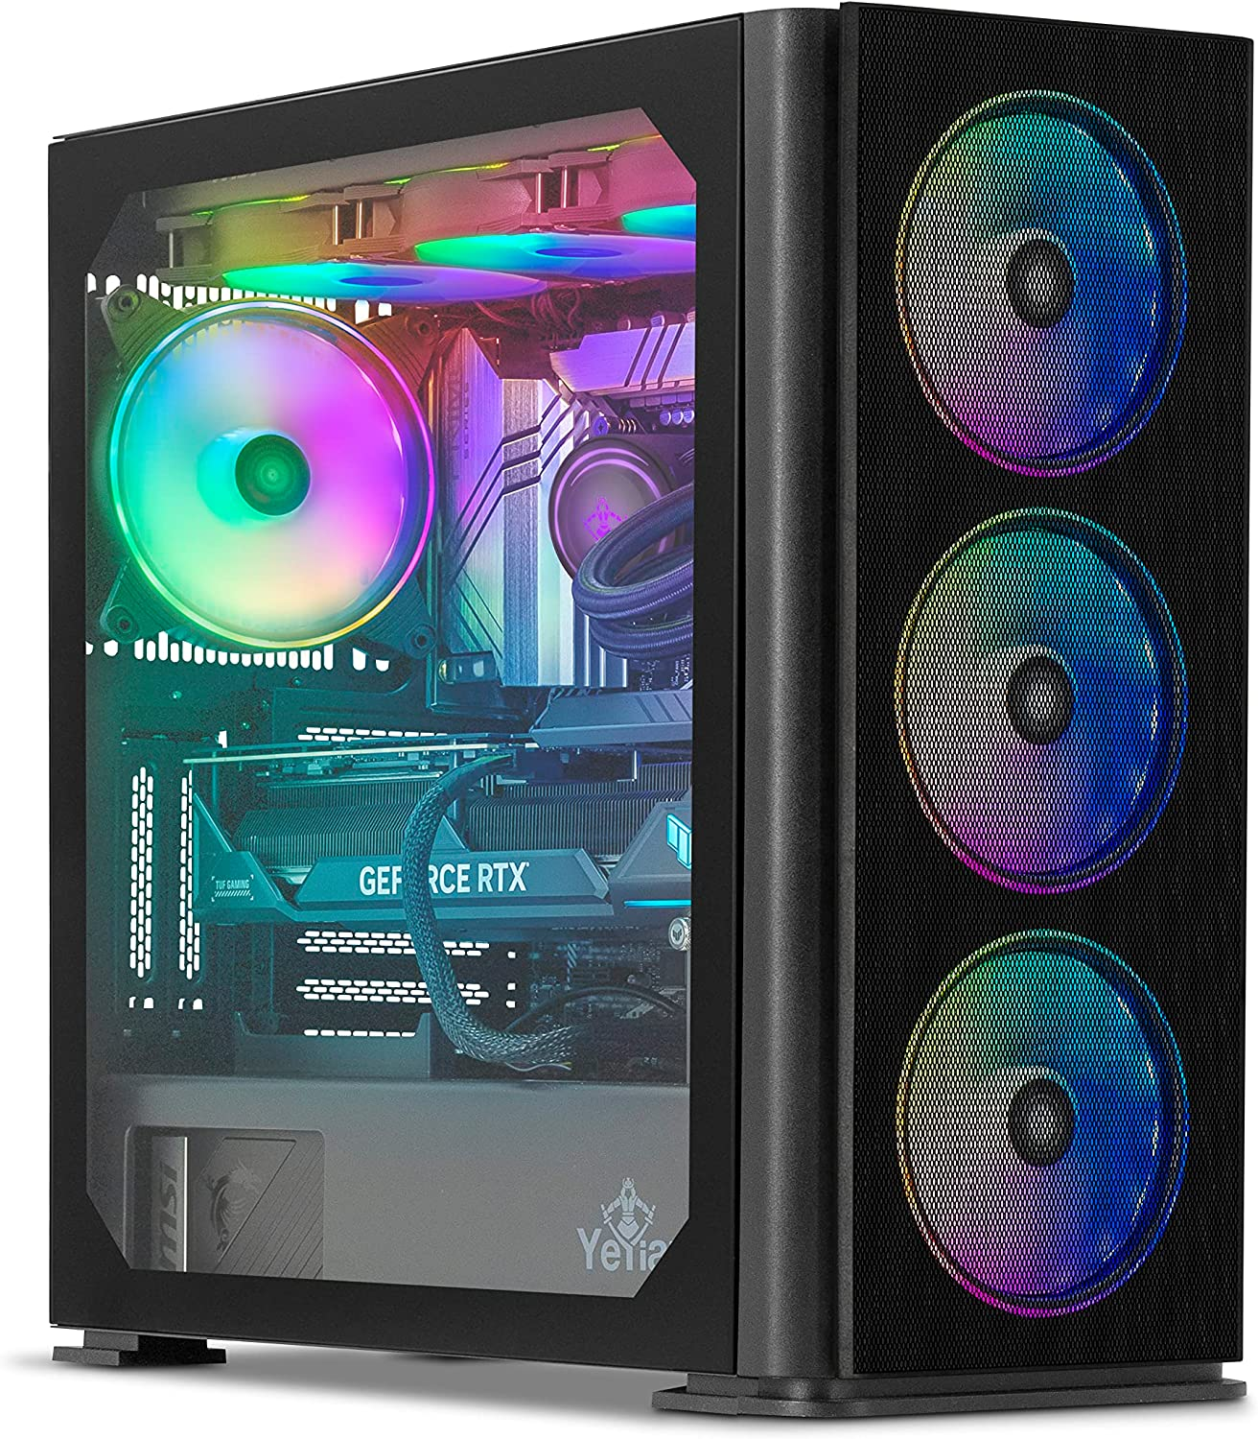
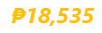
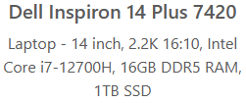
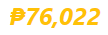
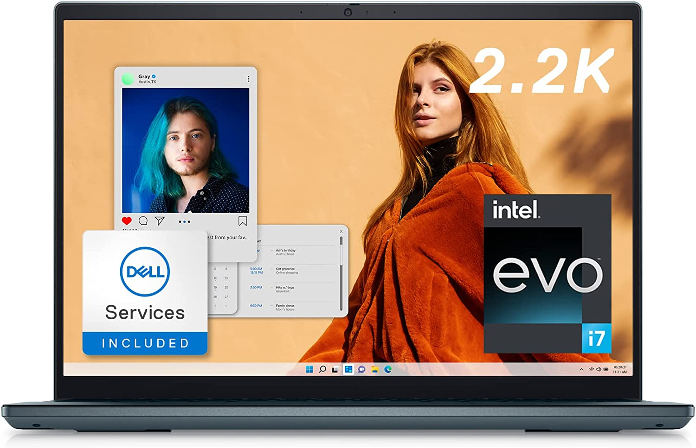
PRODUCT DESCRIPTION AND SPECS
PRODUCT IMAGES
PRODUCT PRICE
Notes:
I gathered resources such as product images, descriptions, specs & online prices.

Slide 12
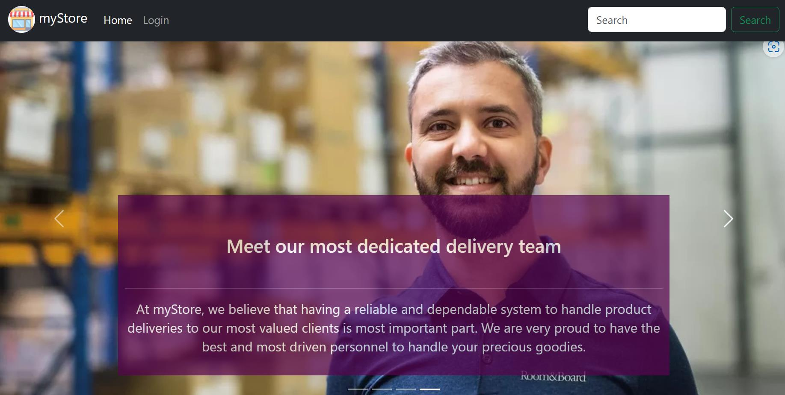
Use case diagram FOR UX DESIGN
Notes:
I created use case diagram and data flow diagram which are the old school equivalent of wire frame in UX Design
I used figma for the initial sketch of the UI design

Slide 13
myStore Online Shopping System
LOGIN
<<include>>
USER INFO
<<include>>
<<include>>
<<include>>
LOGOUT
REGISTERED CUSTOMER
SHOPPING CART
<<include>>
<<include>>
<<include>>
<<include>>
MAKE PURCHASE
<<include>>
CHECKOUT
VIEW PRODUCTS
<<include>>
NON-REGISTERED CUSTOMER
Notes:
This is my use case diagram

Slide 14
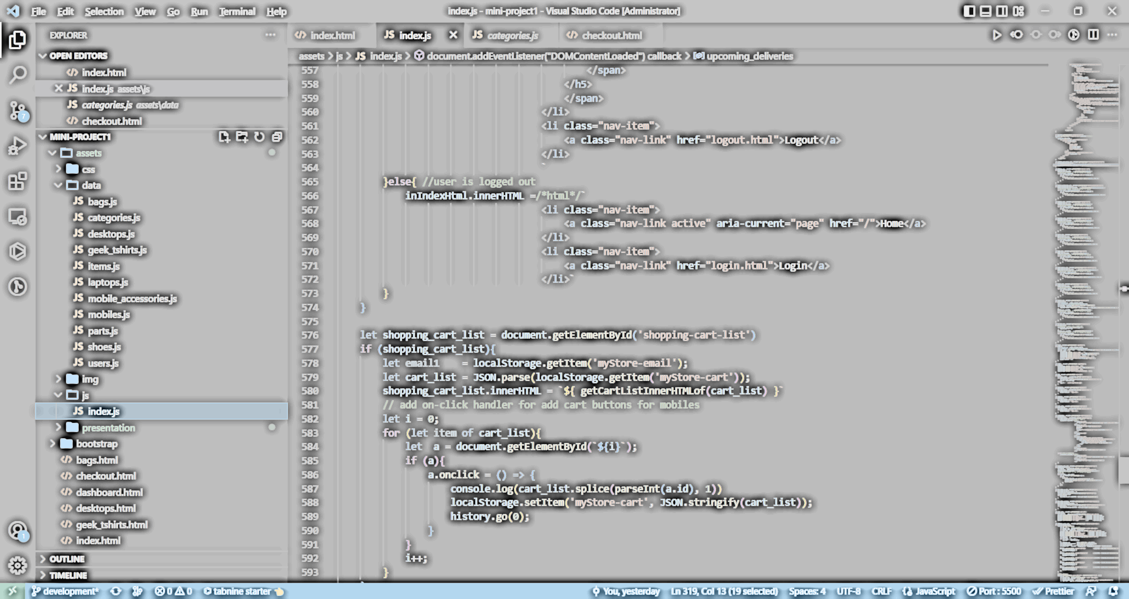
DATA FLOW diagram FOR UX DESIGN
Notes:
A data flow diagram (DFD) is a visual representation of how data flows within a system. It shows the inputs, processes, and outputs of a system, as well as the data stores and entities that interact with the system.
The basic components of a data flow diagram include:
Processes: These represent the functions or activities performed within the system. Each process takes inputs, performs some operation, and produces outputs.
Data Flows: These are the paths through which data moves between the different components of the system, such as processes, data stores, and entities.
Data Stores: These are the places where data is stored within the system, such as databases or files.
Entities: These are the external factors that interact with the system, such as users, customers, or other systems.

Slide 15
CUSTOMER
9.0
1.1
PROD SEARCH
ON SALE LIST
D1
LIST OF PRODUCTS
1.0
HOME
D2
LIST OF CATEGORIES
2.0
6.0
LOGIN
CATEGORY LIST
D3
LIST OF USERS
3.0
7.0
DASHBOARD
D3.1
LIST OF SHOPPING CART ITEMS
SHOPPING
CART
4.0
3.1
CHECKOUT
INCOMING
SHIPMENT
D3.2
LIST OF INCOMING SHIPMENT
5.0
8.0
PAYMENT
myPROFILE
Notes:
This is my data flow diagram
And inside the Home Subsystem is the link to our website
Show Responsive behavior (show in small screen and in tablet)
Loading effect animation/ just pure javascript code no special javascript module
Index html
bootstrap
Nav bar
Search function - shoes
Carousel
Dynamic DOM
Card
Image triggers modal forms
badges
primary button
Bottom Footer (3 cols/
Title and contacts
/ social media links/
external links - Scroll spy
internal links)
Login
Dashboard
myProfile - accordion
Search product /laptop
Select product by category /bag & tshirt
Checkout
accordion
re-used DOM
mode of payment FORM - voucher
logout

Slide 16
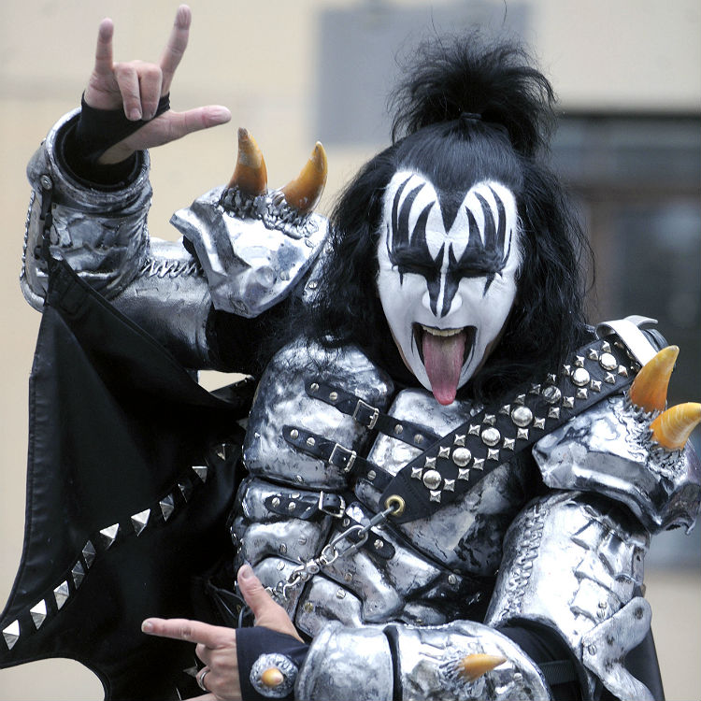


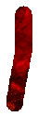





THANK YOU
Garry M. Cacho
gc120978levelup1@gmail.com
www.garrymcacho.com
Web Dev

